Slide 1
Fall of the Romanov Dynasty
MIT ESP Splash 2015
Ray Lardie

Slide 2
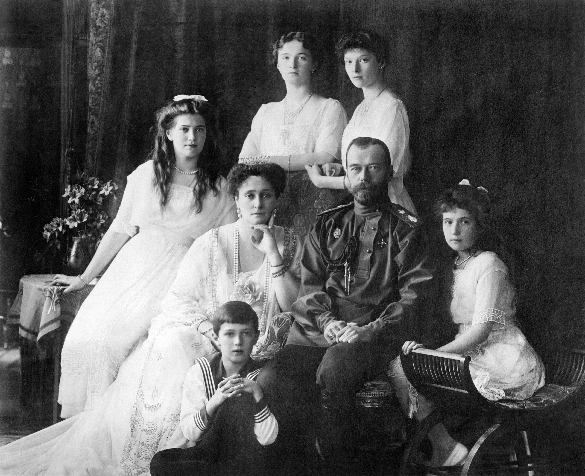
HIM Nikolai II, Emperor and Autocrat of All the Russias
HIM Alexandra Fyodorovna, Empress of all the Russias
HIH Grand Duchess Olga Nikolaevna of Russia
HIH Grand Duchess Tatyana Nikolaevna of Russia
HIH Grand Duchess Maria Nikolaevna of Russia
HIH Grand Duchess Anastasia Nikolaevna of Russia
HIH Tsarevich Alexei Nikolaevich of Russia
Notes:
Executed July 17, 1918 at the Ipatiev House in Yekaterinaburg, Russia

Slide 3
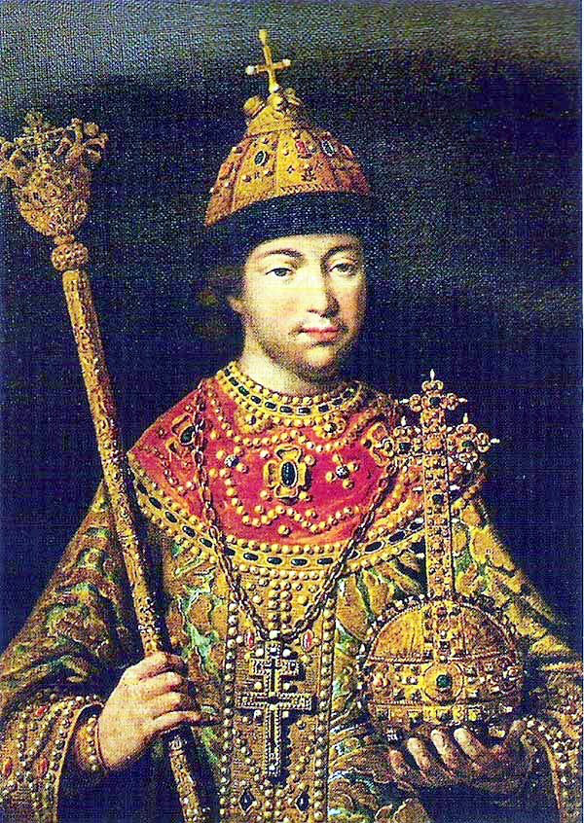
Mikhail Fyodorovich: The Beginning
Mikhail Fyodorovich, first Romanov tsar
Elected and crowned in 1613 by zemskiy sobor, National Assembly
Ended the Time of Troubles, 1598-1613
  Rurik dynasty died out
  Boris Gudonov ruled as tsar, also died
  Cue four different Dmitrii Ivanovich Rurik imposters in rapid succession, three Polish and one Swedish
  Poland and Sweden invade
  Coupled with famine, uppity Cossacks, massive internal refugee crisis, outbreaks of plague, etc
  Finally triggered “surge in Russian patriotism”

Slide 4
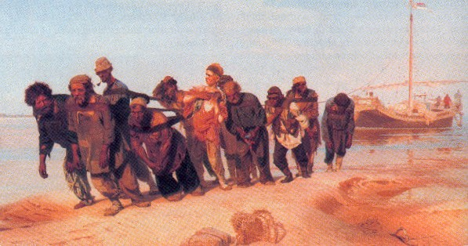
Creation of Serfdom
Medieval form of feudalism traced back to 11th century
Illegal to kill serfs (that was about it)
Technically couldn’t be sold (no one cared)
Bargemen on the Volga, Ilya Repin
Two-week moving period around Yuri’s Day, forbidden in 1597
Notes:
Serf was tied to land, slave could be brought where ever master wished—slavery abolished 1723 Peter Velikyi

Slide 5
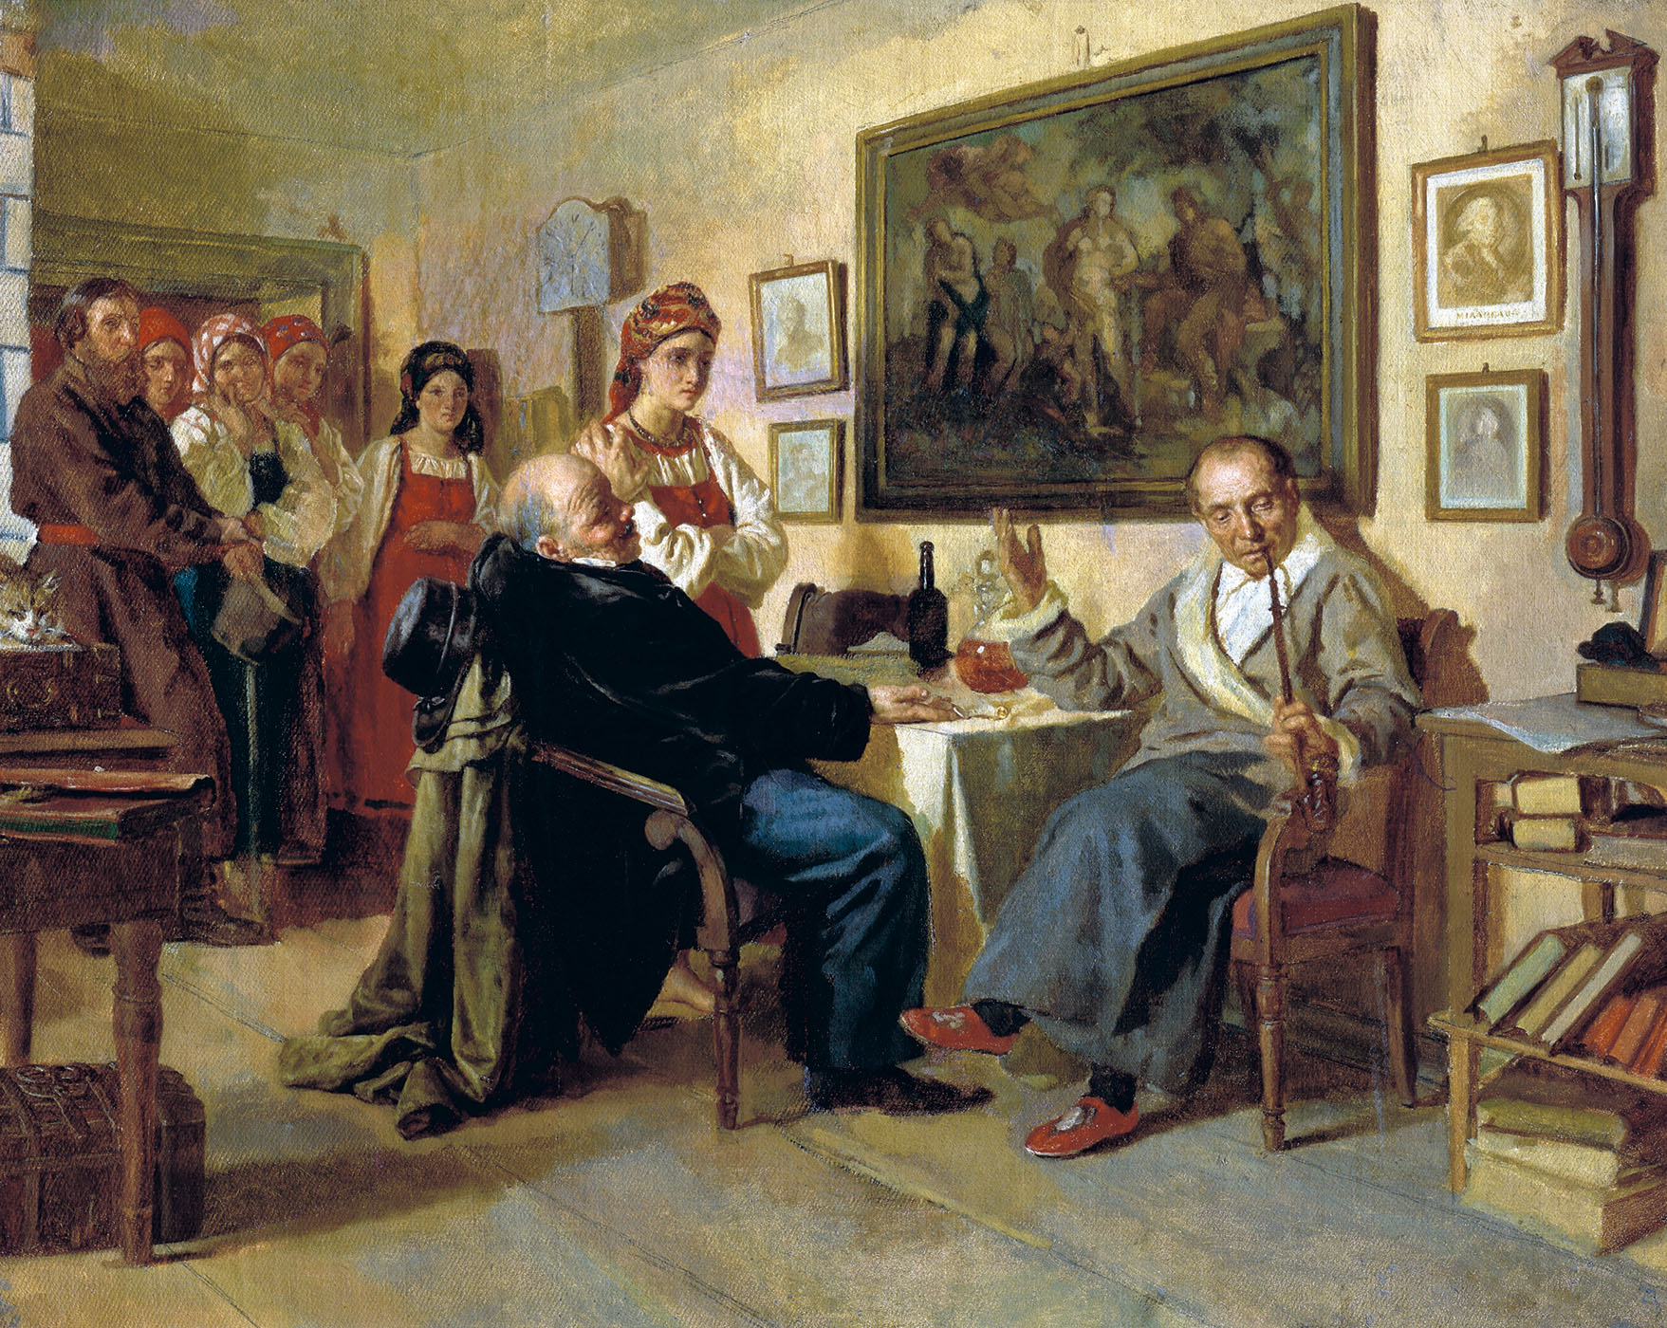
Serfdom Got Worse, Not Better
5-year period to search for runaways extend to 10 years (1642), then permanently (1649)
4 major rebellions
1857 census, 23.1 million serfs out of 62.5 mil population (37.7%)
The Bargain, Nikolai Nevrev
Notes:
Ivan Bolotnikov Rebellion 1606-1607; Stenka Razin Rebellion 1670-1671; Kondraty Bulavin Rebellion 1707-1708; Yemel’yan Pugachyov Rebellion 1773-1774

Slide 6
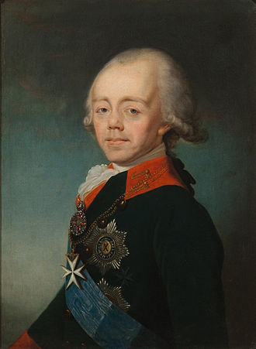
Pavel I: Destruction of Reasonable Succession
Crowned Nov 17, 1796
Hated his mother, Yekaterina Velikaya, to the point of undoing most of her work upon taking the throne
  Recall Russian troops from Iran and Georgia, didn’t send promised reinforcements to Austria and Britain
  Attempted Prussian army reforms
Changed Peter the Great’s succession laws
Notes:
Recalled Russian troops, attempted to reform the army to be more Prussian (drills, discipline, uniforms, ect)

Slide 7
Pauline Succession Law
Pyotr Velikii (Peter the Great) ruled that each reigning monarch could designate their heir
Pavel repelled this and enacted strict succession
Eldest son inherits the throne, from there according to primogeniture
Women could not inherit unless all legitimate male dynasts are dead

Slide 8
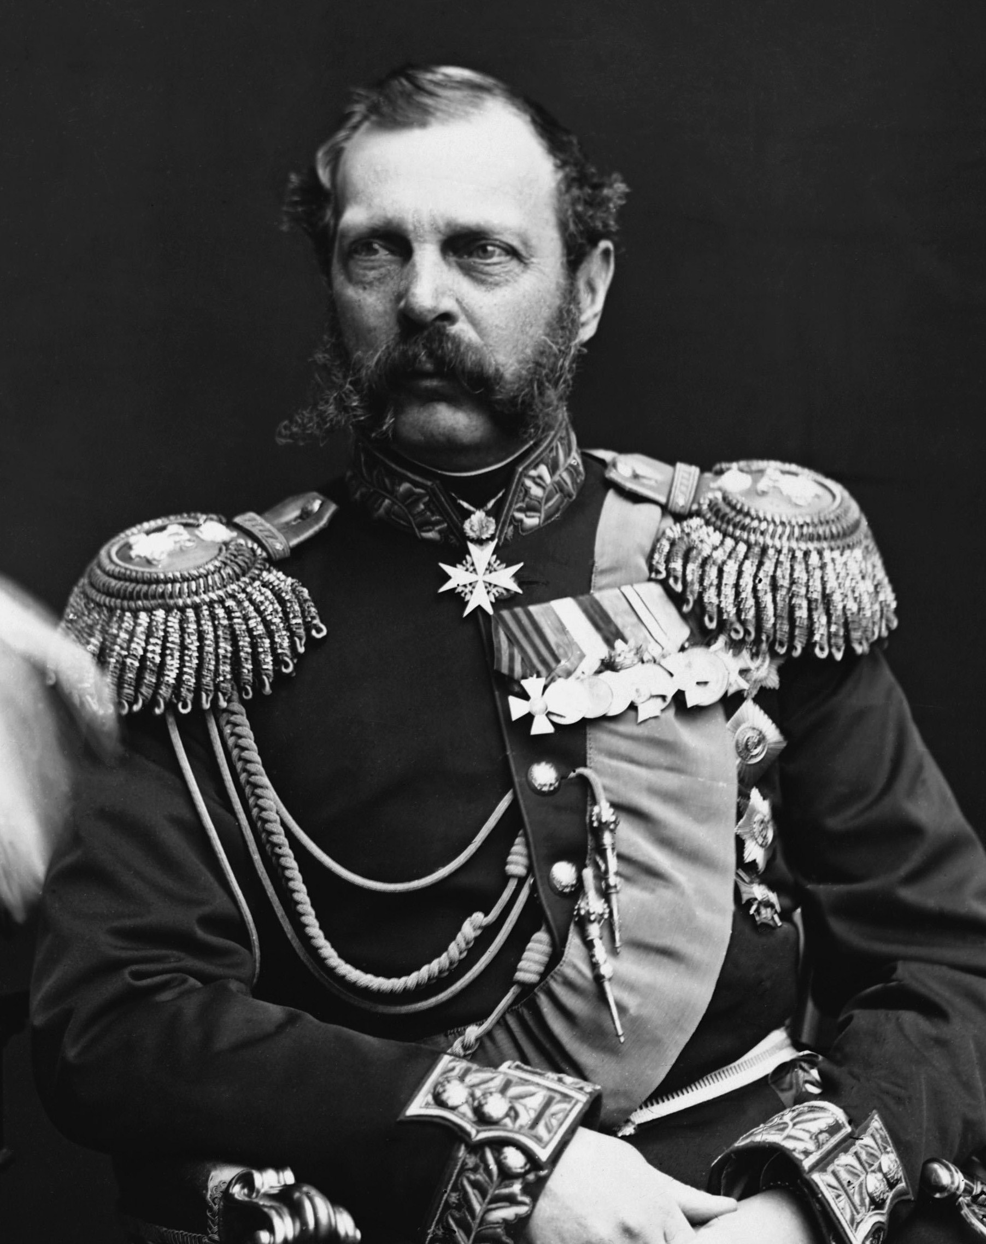
Alexandr II: Liberator
“It is better to begin to destroy serfdom from above than to wait until that time when it begins to destroy itself from below.”
Emancipated serfs in 1861
Freed serfs were given leftover land
Many had to buy more with loans
Loans passed on to children
Also attempted constitutional monarchy
Notes:
Crowned 1855
http://www.historytoday.com/michael-lynch/emancipation-russian-serfs-1861-charter-freedom-or-act-betrayal
http://historyofrussia.org/emancipation-of-the-serfs/

Slide 9
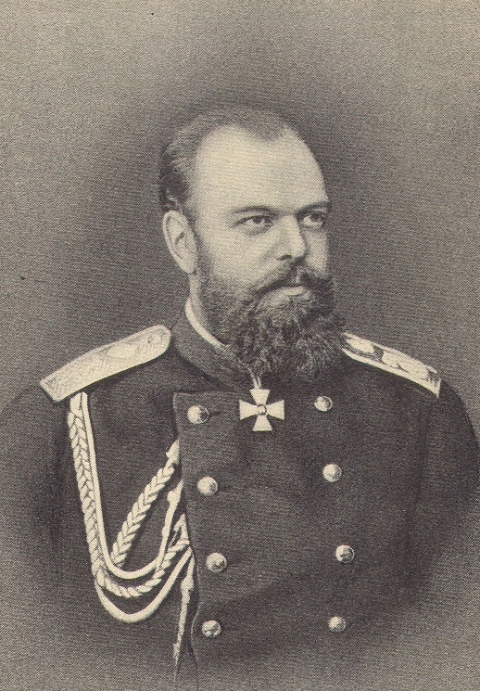
Alexandr III: Tyrant
Wasn’t trained for throne
Responded to father’s death with political crackdown—repelled many of father’s reforms
Believed in Russian Orthodoxy, Autocracy, Nationality
Died aged 49
Notes:
Crowned 1883. Russification, massive censorship. Narodnaya Volya had plot to kill Sasha 3rd; Okhrana uncovered and executed 5 conspirators, one of whom was Aleksandr Ulyanov

Slide 10
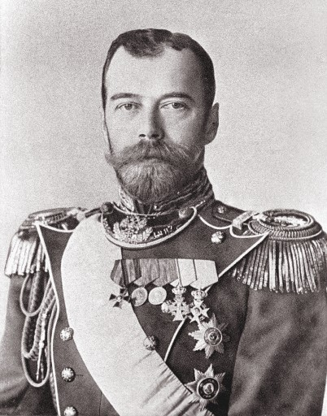
Nikolai II: When It All Fell Apart
Crowned at aged 26, immediate tragedy of Khodynka Field
Conservative like father, absolute monarchist
Reign marred by tragedy:
  Russo-Japanese War
  Bloody Sunday
  Revolution of 1905
  Alexei Nikolaevich
Notes:
30 May 1896 Khodynka, 1389 dead, 1300 injured

Slide 11
Russo-Japanese War
Territorial expansion tensions result in Japanese surprise attack on Port Arthur
Nikolai II grossly overconfident that Russia would win
Supply line delays, and defeat of entire Pacific fleet ultimately forces peace treaty (mediated by America)
Deeply embarrassing loss for Russia, far-flung political consequences

Slide 12
Bloody Sunday
Factor workers suffered long hours, low wages, unsafe conditions
During wide-spread strikes, Father Gapon led a peaceful march to Winter Palace with petition
Troops opened fire; around 1000 killed
Petition Demands
-safer working conditions
-better wages
-eight hour work day
-universal suffrage
-end to the Russo-Japanese War
After Bloody Sunday?
“We no longer have a tsar.”

Slide 13
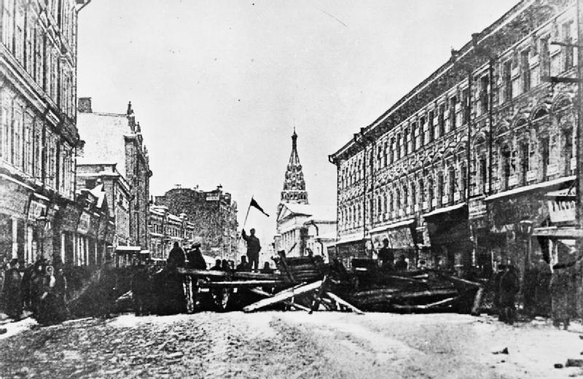
Revolution of 1905
Four major contributing factors:
  ‘Agrarian’ problem
  Nationality inequality
  Labour abuses
  Educated middle class
October Manifesto created Duma, Nikolai regretted this
Revolutionaries continued fighting, violently suppressed: 14k executed

Slide 14
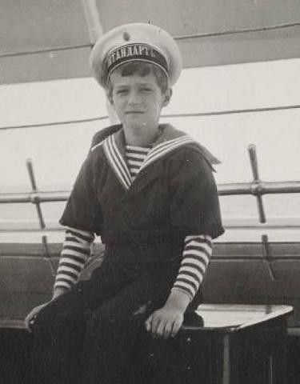
Alexei Nikolaevich: An Empire Sickened
Born Aug. 12th, 1904—hemophiliac
Grigori Rasputin gained favour/power due to apparent ability to heal Alexei
Since illness was state secret, no one knew why Rasputin had so much power
Rumours of affairs spread; Rasputin gave terrible political advice

Slide 15
The Great End
The Great War was disastrous for Russia: by summer 1915, suffered 1.4 million casualties
Public option turned sharply against Alexandra, of German-descent
Alexandra and Rasputin supported Nikolai’s decision to take command of the army
From 1915-1916, imperial authority effectively failed in the capital
Notes:
Lack of equipment

Slide 16
February Revolution
Food shortages finally pushed the people of the edge—riots ensued
When order to put down the riots, army mutinied and sided with the people
Provincial Government formed, put Imperial Family under house arrest
Nikolai returned from front; abdicated on March 15th, 1917

Slide 17
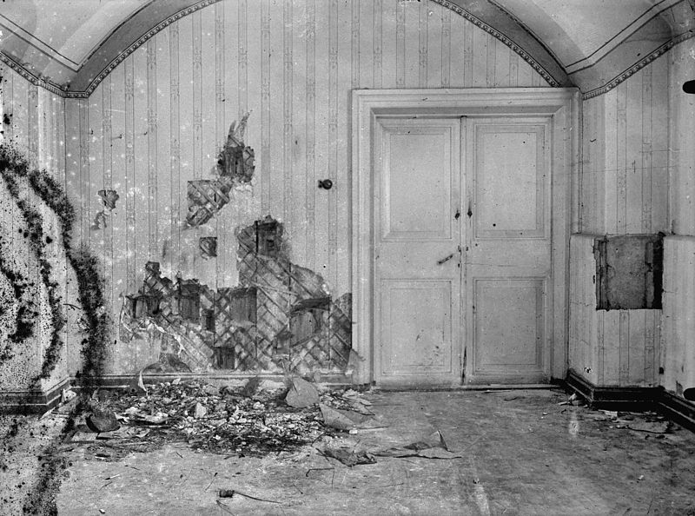
Basement of Ipatiev House after July 17th, 1918
Notes:
1979, Nikolai, Alexandr, three daughters, and four servants found; in 2007, the fourth daughter and Alexei have been found

Slide 18
Resources
A History of Russia, by Nicholas Riasanovsky
Nicholas and Alexandra, by Robert K Massie
Imperial Russia: A Source book 1700-1917, Basil Dmytryshyn
Land of the Firebird, Suzanne Massie
Slides will be up on Splash site by end of day; Z9929-teachers@esp.mit.edu

